Slide 1
CS 211 Computer Architecture Floating Point Numbers
Ravi Mittal
ravi.mittal@iitgoa.ac.in
Indian Institute of Technology, Goa

Slide 2
Floating Point topics we will cover
Background: Fractional binary numbers
IEEE floating point standard: Definition
Example and properties
Rounding, addition, multiplication
Floating point in C
Summary

Slide 3
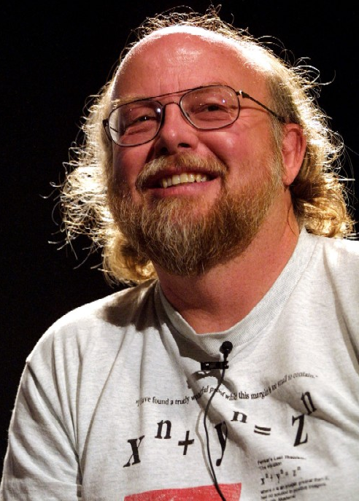
Floating Point Quote
“95% of the folks out there are completely clueless about floating-point.”
James Gosling Feb. 28, 1998
James Gosling
Sun Fellow
Java Inventor

Slide 4
Towards Floating Point Number

Slide 5
Reasoning about Fractions
Big Idea: Why can’t we represent fractions? Because our bits all represent nonnegative powers of 2.
Example: 10 1010_{two} = 1×2⁵ + 1×2³ + 1×2¹ = 42_{ten}
The lowest power of 2 is 2⁰, so the smallest difference between any two numbers is 2⁰ = 1.
Example: 10 1011_{two} = 42+1 = 43_{ten}
Example 6-bit representation:
0b xx xxxx
2⁵
2⁰
2⁴
2³
2²
2¹

Slide 6
Representation of Fractions
New Idea: Introduce a fixed “Binary Point” that signifies boundary between negative and nonnegative powers:
Example: 10.1010_{two} = 1×2¹ + 1×2⁻¹ + 1×2⁻³ = 2.625_{ten}
Binary point numbers that match the 6-bit format above range from 0 (00.0000_{two}) to 3.9375 (11.1111_{two})
Example 6-bit representation:
0b xx.xxxx
2¹
2⁻⁴
2⁰
2⁻¹
2⁻²
2⁻³

Slide 7
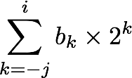
Fractional Binary Numbers
2^{i}
2^{i-1}
4
2
1
• • •
bi | bi-1 | ••• | b2 | b1 | b0 | b-1 | b-2 | b-3 | ••• | b-j
1/2
1/4
1/8
2^{-j}
• • •
Representation
Bits to right of “binary point” represent fractional powers of 2
Represents rational number:
Notes:
Latex source for equation: \sum_{k=-j}^i b_k \times 2^k

Slide 8
Fractional Binary Numbers: Examples
Value Representation
5 3/4 101.112
2 7/8 010.1112
63/64 001.01112
Observations
Divide by 2 by shifting right
Multiply by 2 by shifting left
Numbers of form 0.111111…2 are just below 1.0
1/2 + 1/4 + 1/8 + … + 1/2^{i} + … ➙ 1.0
Notes:
ε : Epsilon

Slide 9
Representable Numbers
Limitation
Can only exactly represent numbers of the form x/2^{k}
Other rational numbers have repeating bit representations
Gives approximate number
Value Representation
1/3 0.0101010101[01]…2
1/5 0.001100110011[0011]…2
1/10 0.0001100110011[0011]…2

Slide 10
Number Representation Limitations
Given 32 bits (a word), what can we represent so far?
Signed and Unsigned Integers
4 Characters (ASCII)
Instructions and Addresses
How do we encode the following:
Real numbers (e.g. 3.14159)
Very large numbers (e.g. 6.02×1023)
Very small numbers (e.g. 6.626×10-34)
Special numbers (e.g. ∞, NaN)
Floating
Point
Notes:
We’re gonna be finishing up Number Representation.

Slide 11
Scientific Notations

Slide 12
Scientific Notation (Decimal)
significand
exponent
2.625_{ten} × 10²³
Normalized form: exactly one digit (non-zero) to left of decimal point (the point “floats” to be in the standard position)
Alternatives to representing 1/1,000,000,000
Normalized: 1.0×10⁻⁹
Not normalized: 0.1×10⁻⁸, 10.0×10⁻¹⁰
decimal point
radix (base)
Notes:
Begin this slide by remembering to say that in order to keep track of where the point “floats” to, we store that info in the exponent number

Slide 13
Scientific Notation (Binary)
exponent
significand
1.0101_{two} × 2¹
Computer arithmetic that supports this called floating point due to the “floating” of the binary point
Declare such variable in C as float
binary point
radix (base)

Slide 14
Translating To and From Scientific Notation
Consider the number 1.011_{two}×2⁴
To convert to ordinary number, shift the decimal to the right by 4
Result: 10110_{two} = 22_{ten}
For negative exponents, shift decimal to the left
1.011_{two}×2⁻² => 0.01011_{two} = 0.34375_{ten}
Go from ordinary number to scientific notation by shifting until in normalized form
1101.001_{two} => 1.101001_{two}×2³
Notes:
Put the point behind the first “significant” bit

Slide 16
Floating Point Numbers

Slide 17
Ariane 5
Ariane 5 - a heavy-lift space launch vehicle developed and operated by Arianespace for the European Space Agency. It was launched from the Centre Spatial Guyanais in French Guiana. It has been used to deliver payloads into geostationary transfer orbit or low Earth orbit.

Slide 18
This is important!
Ariane 5 explodes on maiden voyage: $500 MILLION dollars lost
64-bit floating point number assigned to 16-bit integer
Causes rocket to get incorrect value of horizontal velocity and crash
Patriot Missile defense system misses scud – 28 people die
System tracks time in tenths of second
Converted from integer to floating point number
Accumulated rounding error causes drift. 20% drift over 8 hours.
Eventually (on 2/25/1991 system was on for 100 hours) causes range mis-estimation sufficiently large to miss incoming missiles.

Slide 19
Goals of Floating Point
Support a wide range of values
Both very small and very large
Keep as much precision as possible
Help programmer with errors in real arithmetic
Support +∞, -∞, Not-A-Number (NaN), exponent overflow and underflow
Driven by numerical concerns
Positional notation is not effective in representing very large numbers
Representation of 5 × 2¹⁰⁰ would consist of the bit pattern 101 followed by 100 zeros
Notes:
Want floating point to look more “”natural” in that small unsigned value -> small floating point value

Slide 20

“Father” of Floating Point Standard
IEEE Standard 754 for Binary Floating-Point Arithmetic
1989 ACM Turing Award Winner!
Prof. Kahan
Prof. Emeritus
UC Berkeley
www.cs.berkeley.edu/~wkahan/ieee754status/754story.html
Notes:
1:30 in

Slide 21
Floating Point Encoding
Use normalized, Base 2 scientific notation: +1.xxx…x_{two}×2^{yyy…y}two
Split a 32-bit word into 3 fields:
S represents Sign (1 is negative, 0 positive)
Exponent represents y’s
Significand represents x’s
Key Idea: More like Sign and Magnitude
31 30
23 22
0
S
Exponent
Significand
1 bit
8 bits
23 bits
Notes:
Woah! We are splitting a 32 bit number into three fields. Does this look familiar? YES. Just like instructions formats!

Slide 22
Comparison
Which is smaller? (i.e. closer to -∞)
0 or 1 x 10⁻¹²⁷ ?
1 x 10⁻¹²⁶ or 1 x 10⁻¹²⁷ ?
-1 x 10⁻¹²⁷ or 0 ?
-1 x 10⁻¹²⁶ or -1 x 10⁻¹²⁷ ?
Which is smaller? (i.e. closer to -∞)
0 or 1 x 10⁻¹²⁷ ?
1 x 10⁻¹²⁶ or 1 x 10⁻¹²⁷ ?
-1 x 10⁻¹²⁷ or 0 ?
-1 x 10⁻¹²⁶ or -1 x 10⁻¹²⁷ ?
Which is smaller? (i.e. closer to -∞)
0 or 1 x 10⁻¹²⁷ ?
1 x 10⁻¹²⁶ or 1 x 10⁻¹²⁷ ?
-1 x 10⁻¹²⁷ or 0 ?
-1 x 10⁻¹²⁶ or -1 x 10⁻¹²⁷ ?
Which is smaller? (i.e. closer to -∞)
0 or 1 x 10⁻¹²⁷ ?
1 x 10⁻¹²⁶ or 1 x 10⁻¹²⁷ ?
-1 x 10⁻¹²⁷ or 0 ?
-1 x 10⁻¹²⁶ or -1 x 10⁻¹²⁷ ?
Which is smaller? (i.e. closer to -∞)
0 or 1 x 10⁻¹²⁷ ?
1 x 10⁻¹²⁶ or 1 x 10⁻¹²⁷ ?
-1 x 10⁻¹²⁷ or 0 ?
-1 x 10⁻¹²⁶ or -1 x 10⁻¹²⁷ ?

Slide 23
The Exponent Field
Use biased notation
Read exponent as unsigned, but with bias of 127
Exp field ranges from -127 (00000000_{two}) to 128 (11111111_{two})
Exponent 0 is represented as 01111111_{two} = 127_{ten}
To encode in biased notation, add the bias (add 127) then encode in unsigned:
If we had 2¹, exp = 1 => 128 => 10000000_{two}
2¹²⁷: exp = 127 => 254 => 11111110_{two}

Slide 24
The Exponent Field
Why use biased notation for the exponent?
Remember that we want floating point numbers to look small when their actual value is small
We don’t like how in 2’s complement, -1 looks bigger than 0. Bias notation preserves the linearity of value
Recall that only the first bit denotes sign
Thus, floating point resembles sign and magnitude
magnitude
31 30
23 22
0
S
Exponent
Significand
1 bit
8 bits
23 bits

Slide 25
Floating Point Encoding
What does this mean?
Think of it as: (1 + Value of Significand)
Since the Significand represents all the negative powers of 2, its total value is always < 1
Example: 1.0101_{two} = 1 + 2⁻² + 2⁻⁴ = 1.3125
31 30
23 22
0
S
Exponent
Significand
1 bit
8 bits
23 bits
(-1)^{S} x (1 . Significand) x 2^{(Exponent-127)}
Notes:
Why have the 1? Be sneaky and save a bit
Add animations

Slide 26
Floating Point Encoding
Note the implicit 1 in front of the Significand
Ex: 0011 1111 1100 0000 0000 0000 0000 0000_{two}
(-1)⁰ x (1 . 1_{two}) x 2⁽¹²⁷⁻¹²⁷⁾ = (1 . 1_{two}) x 2⁽⁰⁾
1.1_{two} = 1.5_{ten}, NOT 0.1_{two} = 0.5_{ten}
Gives us an extra bit of precision
31 30
23 22
0
S
Exponent
Significand
1 bit
8 bits
23 bits
(-1)^{S} x (1 . Significand) x 2^{(Exponent-127)}
Notes:
Tell them to remember the number 23!!!!

Slide 27
Floating Point Encoding
Note the implicit 1 in front of the Significand
Ex: 0011 1111 1100 0000 0000 0000 0000 0000_{two}
(-1)⁰ x (1 . 1_{two}) x 2⁽¹²⁷⁻¹²⁷⁾ = (1 . 1_{two}) x 2⁽⁰⁾
1.1_{two} = 1.5_{ten}, (NOT that 0.1_{two} = 0.5_{ten} )
This gives us an extra bit of precision
31 30
23 22
0
S
Exponent
Significand
1 bit
8 bits
23 bits
(-1)^{S} x (1 . Significand) x 2^{(Exponent-127)}
Notes:
Tell them to remember the number 23!!!!

Slide 28
Precision options
Single precision: 32 bits
Double precision: 64 bits
Other formats: half precision, quad precision
s | exponent | Frac or Significand
1 | 8-bits | 23-bits
s | exponent | Frac pr Significand
1 | 11-bits | 52-bits

Slide 29
Single Precision - Notationa
s | exponent | Fracrion or Significand
1 | 8-bits | 23-bits
S: sign bit (0 ⇒ non-negative, 1 ⇒ negative)
Normalize significand: 1.0 ≤ |significand| < 2.0
Always has a leading pre-binary-point 1 bit, so no need to represent it explicitly (hidden bit)
Significand is Fraction with the “1.” restored
Exponent: excess representation: actual exponent + Bias
Ensures exponent is unsigned
Single: Bias = 127; Double: Bias = 1203

Slide 30
Single Precision
s | exp | frac
1 | 8-bits | 23-bits
S: sign bit (0 ⇒ non-negative, 1 ⇒ negative)
Normalize significand: 1.0 ≤ |significand| < 2.0
Always has a leading pre-binary-point 1 bit, so no need to represent it explicitly (hidden bit)
Significand is Fraction with the “1.” restored
Exponent: excess representation: actual exponent + Bias
Ensures exponent is unsigned
Single: Bias = 127; Double: Bias = 1203

Slide 31
Precision and Accuracy
Don’t confuse these two terms!
Precision is a count of the number of bits in a computer word used to represent a value
Accuracy is a measure of the difference between the actual value of a number and its computer representation
High precision permits high accuracy but doesn’t guarantee it. It is possible to have high precision but low accuracy.
Example: float pi = 3.14;
pi will be represented using all 24 bits of the significand (highly precise), but is only an approximation (not accurate)
Notes:
Maybe cut out this slide. Not relevant

Slide 32
Floating Point – Special Cases

Slide 33
Floating Point Numbers - Special Cases
Exponent | Significand | Meaning
0x00 | ? | ?
0x00 | ? | ?
0x01 – 0xFE | anything | ± Num
0xFF | ? | ?
0xFF | ? | ?

Slide 34
Representing Zero
But wait… what happened to zero?
Using standard encoding 0x00000000 is 1.0×2⁻¹²⁷≠0
All because of implicit 1
Special case: Exp and Significand all zeros = 0
Two zeros! One for each sign bit +0 and -0
So, coded 0x00000000 = 0
Notes:
Fix slides so looks pretty

Slide 35
Floating Point Numbers - Special Cases
Exponent | Significand | Meaning
0x00 | 0 | ± 0
0x00 | ? | ?
0x01 – 0xFE | anything | ± Num
0xFF | ? | ?
0xFF | ? | ?

Slide 36
Representing Very Small Numbers
What are the normal numbers closest to 0? (here, normal means the exponent is nonzero)
a = 1.0…00_{two}×2¹⁻¹²⁷ = (1+ 0 ) x 2⁻¹²⁶ = 2⁻¹²⁶
b = 1.0…01_{two}×2¹⁻¹²⁷ = (1+2⁻²³) x 2⁻¹²⁶ = 2⁻¹²⁶ + 2⁻¹⁴⁹
Gaps!
b
+∞
-∞
0
a
The gap between 0 and a is 2⁻¹²⁶
The gap between a and b is 2⁻¹⁴⁹
We want to represent numbers between 0 and a
How? The implicit 1 forces the 2-126 term to stay :(
Solution: Take out the implicit 1!
Special case: Exp = 0, Significand ≠ 0 are denorm numbers

Slide 37
Denorm Numbers
Short for “denormalized numbers”
No leading 1
Careful! Denorm exponent bias is now 126 when Exp = 0x00
Now what do the gaps look like?
Smallest denorm: ± 0.0…01_{two}×2⁻¹²⁶ = ± 2⁻¹⁴⁹
Largest denorm: ± 0.1…1_{two}×2⁻¹²⁶ = ± (2⁻¹²⁶ – 2⁻¹⁴⁹)
Smallest norm: ± 1.0…0_{two}×2⁻¹²⁶ = ± 2⁻¹²⁶
So much closer to 0
No uneven gap! Increments by 2⁻¹⁴⁹
Notes:
Here’s another exercise: reason about why the denorm bias is 126 by trying to evaluate the two floating point number that surround a in the previous slide

Slide 38
Floating Point Representation
Example: 15213₁₀ = (-1)⁰ x 1.1101101101101₂ x 2¹³
Numerical Form: (–1)^{s} M 2E
Sign bit s determines whether number is negative or positive
Significand M normally a fractional value in range [1.0,2.0).
Ranges between 1 and 2 – ε ; or between 0 and 1 – ε
Exponent E weights value by power of two
Encoding
MSB s is sign bit s
exp field encodes E
frac field encodes M
s | exp | frac

Slide 39
Floating Point Numbers - Special Cases
Exponent | Significand | Meaning
0x00 | 0 | ± 0
0x00 | non-zero | ± Denorm Num
0x01 – 0xFE | anything | ± Num
0xFF | ? | ?
0xFF | ? | ?

Slide 40
Other Special Cases
Exp = 0xFF, Significand = 0: ± ∞
e.g. division by 0
Still work in comparisons
Exp = 0xFF, Significand ≠ 0: Not a Number (NaN)
e.g. square root of negative number, 0/0, ∞–∞
NaN propagates through computations
In theory: Significand can be useful for debugging
Largest value (besides ∞)?
Exp = 0xFF has now been taken! Exp = 0xFE has largest: 1.1…1_{two}×2¹²⁷ = 2¹²⁸ – 2¹⁰⁴
Notes:
Remind students that there are different types of NaNs but they won’t be tested on them,they just needa know what the range of all NaNs are

Slide 41
Floating Point Numbers - Special Cases
Exponent | Significand | Meaning
0x00 | 0 | ± 0
0x00 | non-zero | ± Denorm Num
0x01 – 0xFE | anything | ± Num
0xFF | 0 | ± ∞
0xFF | non-zero | NaN

Slide 42
Limitations of Floating Point Numbers

Slide 43
Floating Point Limitations (1/2)
What if result x is too large? (abs(x)> 2¹²⁸)
Overflow: Exponent is larger than what can be represented
What if result x too small? (0 < abs(x)< 2⁻¹⁴⁹)
Underflow: Negative exponent is larger than can be represented
What if result runs off the end of the Significand?
Rounding occurs and can lead to unexpected results
FP has different rounding modes
overflow
underflow
overflow
-2¹²⁸
-1
-2⁻¹⁴⁹
0
2⁻¹⁴⁹
1
2¹²⁸
Notes:
Have another slide explaining about the gaps that come about when the exponent field changes
Remember that we can only represent 2³² distinct things. Just bc we have a bigger range doesnt mean we get more numbers. We lose precision as we have higher exponents

Slide 44
Trivia …

Slide 45
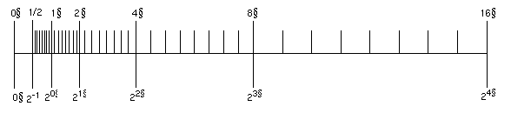
Floating Point Gaps
Does adding 0x00000001 always add the same value to the floating point number?
NO—it’s value depends on the exponent field
ex: 1.0_{two} x 2² = 4 1.0_{two} x 2³ = 8 1.1_{two} x 2² = 6 1.1_{two} x 2³ = 12
Thus floating points are quite different from the number representations you’ve learned so far
+2
+4
Notes:
Have another slide explaining about the gaps that come about when the exponent field changes
Remember that we can only represent 2³² distinct things. Just bc we have a bigger range doesnt mean we get more numbers. We lose precision as we have higher exponents

Slide 46


Big Data, this is just the Beginning
The number of stars in the universe
10²³
You are here
Sensors & Devices
World's Data (Bytes)
Social Media
VoIP
Enterprise Data
2010
2015
Notes:
“The Internet of [Things] could raise the level of U.S. gross domestic product by 2%-5% by 2025.
This gain… if realized, would boost the annual U.S. GDP growth rate by 0.2%-0.4% points over this period, bringing growth closer to 3% per year.”

Slide 47
Computing Needs are continuously changing… more and more computing power is required… at lower cost

Slide 48
No free lunch for software engineers… Moore’s law is reducing … Transistor count is not doubling every two years… Power wall issue.. Memory wall issue..

Slide 49
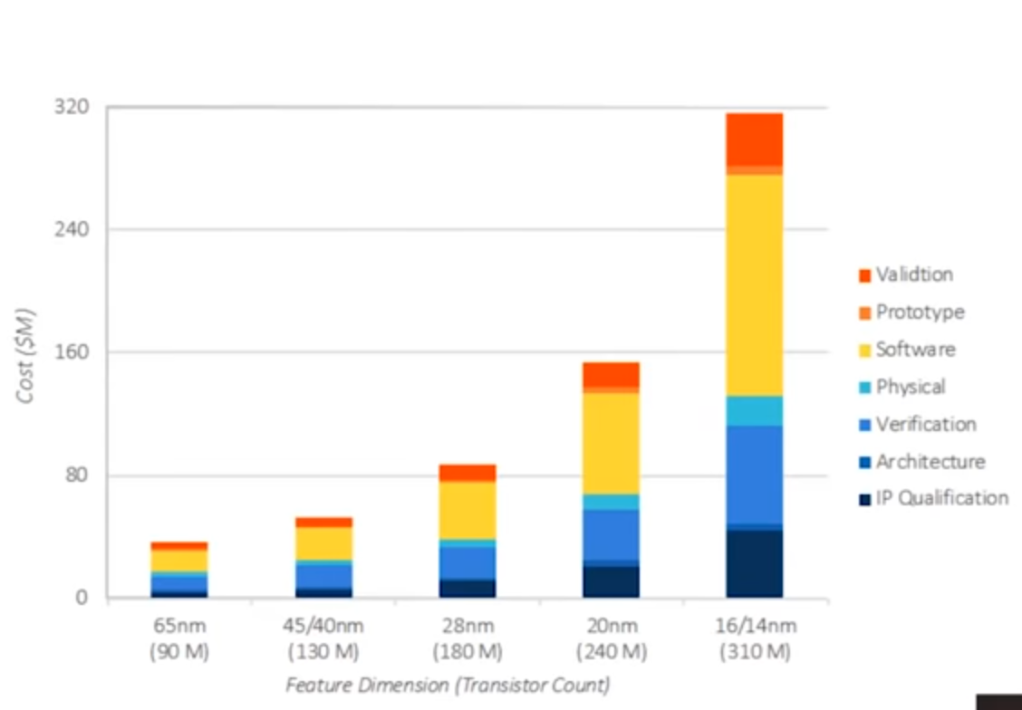
Cost of making Chips is increasing…

Slide 50
Why can’t we copy the success from software?

Slide 51


Slide 52
How did Instagram turn into USD 1Billion acquisition with only 13 employees?

Slide 53


Power of Open Source

Slide 54
A Success Story
He led a life full of hardships as his family struggled hard to meet ends meet. His house did not even have electricity, says Forbes
He and his mother migrated to Mountain View and managed to get a two-bedroom apartment with the help of government support
He used to do menial jobs like cleaning and mopping at a grocery store while his mother took up a baby sitting job. Life took a tragic turn when his mother was diagnosed with cancer
By 18, he learnt computer networking all by himself with the help of manuals from a used book store
Finally, he enrolled at San Jose State University worked at Ernst & Young as a security tester

Slide 55
A Success Story .. continues
Joined Yahoo and left it ..
Along with a friend, he developed a software ..a messaging application
He released this application.. Active users went up to 250K
By 2011, the app was in the top 20 apps
By 2013, the app had active user base of 200 million
Today, it’s user base is over 450 million
Now, it has just 32 engineers
Facebook acquired this application for USD 16 Billion
What is this application?

Slide 56
What is this application?
Instagram
Zoom
Messenger
WhatsApp
Snapchat
Youtube

Slide 57
What is this application?
Instagram
Zoom
Messenger
WhatsApp
Snapchat
Youtube

Slide 58

Who is this person?
Jan Koum

Slide 59
Learning…
You too can innovate…
You need to learn to be creative…
Ready to dirty your hands..
Power of open source software…
You can create amazing applications with open source software..
Linux
GNU compiler collection
Python
PHP
Blender

Slide 60
Why hardware in not opensource..
Some companies monopolized the market..
Intel’s ISA is known.. But not micro-code
You can’t design your own chip unless you invest millions..
Implementation details of ARM, MIPS, Intel, etc are not open-sourced..
You don’t have access to code and design libraries
It’s changing now … with RISC V
Open source Hardware
Developed to support many applications
Desktop, Mobiles, GPUs, Special purpose processors

Slide 61

We will study RISC V

Slide 62
Towards Two’s complement number

Slide 63
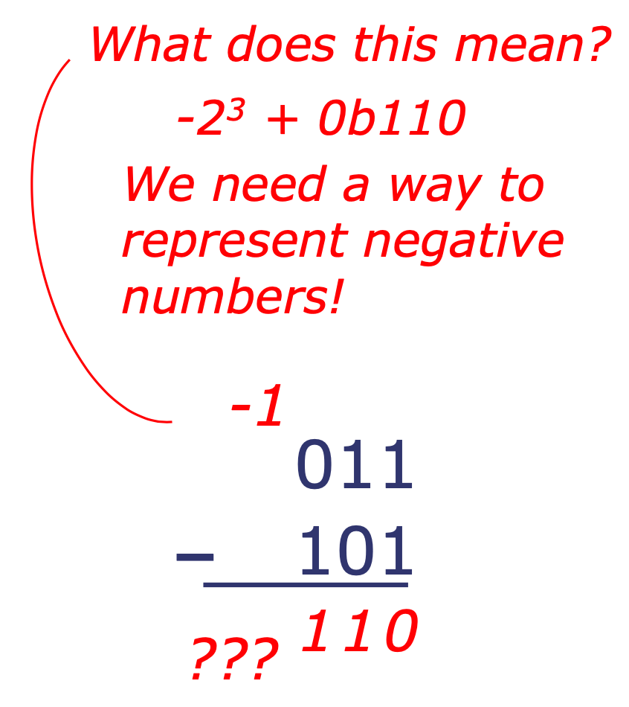
Negative number..concept
Computers cant do subtraction easily if we use sign and magnitude representation
CS 305: Computer Architecture

Slide 64
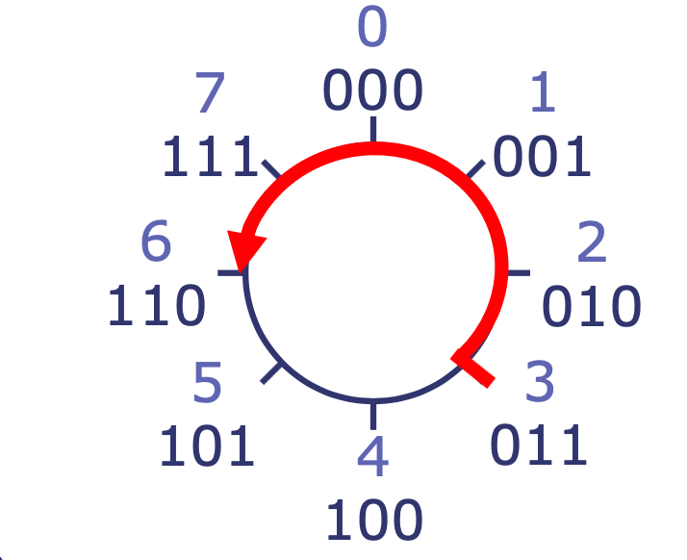
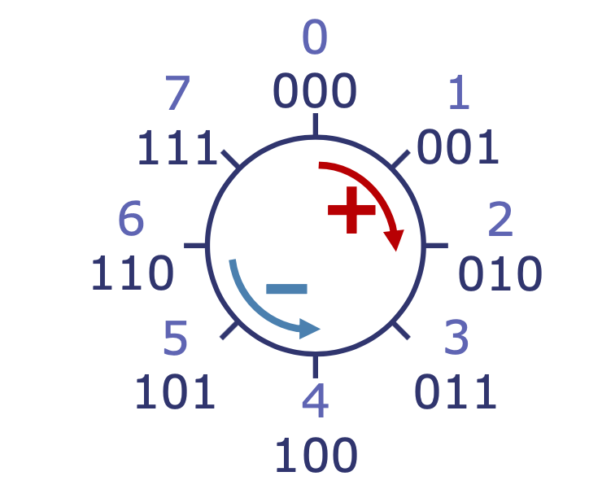
Binary Modular Arithmetic
If we use a fixed number of bits, addition and other operations may produce results outside the range that the output can represent (up to 1 extra bit for addition)
This is known as an overflow
Common approach: Ignore the extra bit
Gives rise to modular arithmetic: With N-bit numbers, equivalent to following all operations with mod 2^{N}
Visually, numbers “wrap around”:

Slide 65
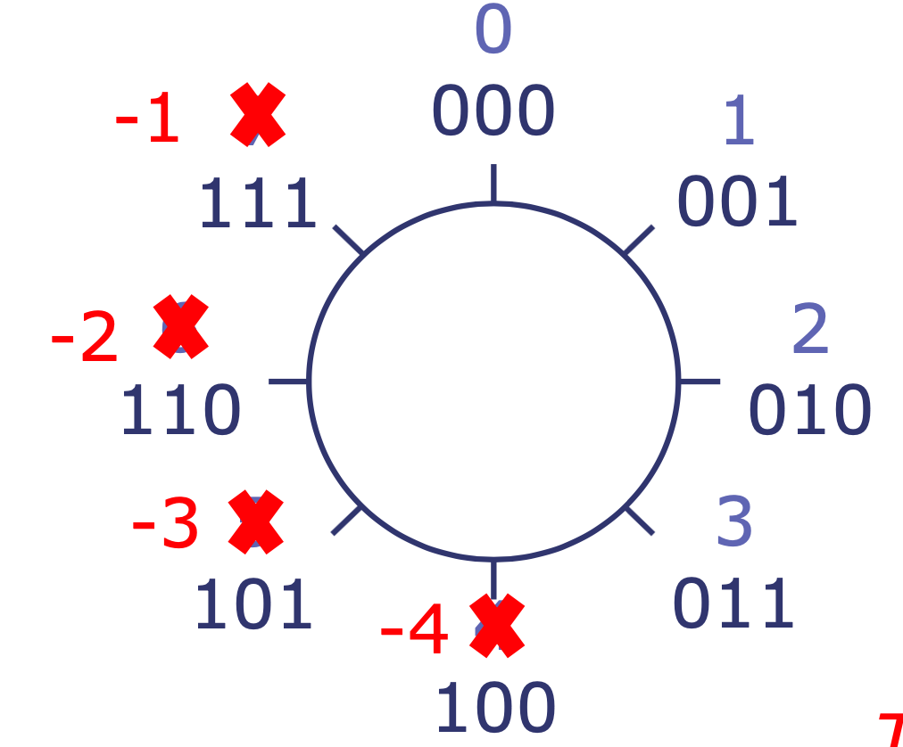
Representing negative numbers
We can simply relabel some of the digits to represent negative numbers while representing the nice properties of modular arithmetic
This is called 2’s
Complement Encoding

Slide 66
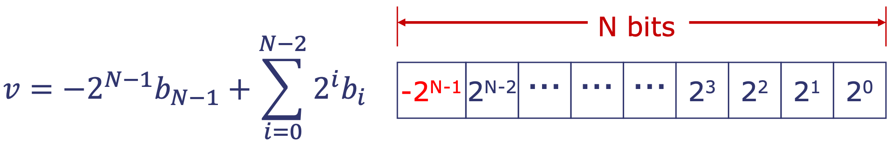
2’s complement encoding
In two’s complement encoding, the high-order bit of the N-bit representation has negative weight:
Negative numbers have “1” in the high-order bit
Most negative number? 10...0000 -2^{N-1}
Most positive number? 01...1111 +2^{N-1} - 1
If all bits are 1? 11...1111 - 1

Slide 67
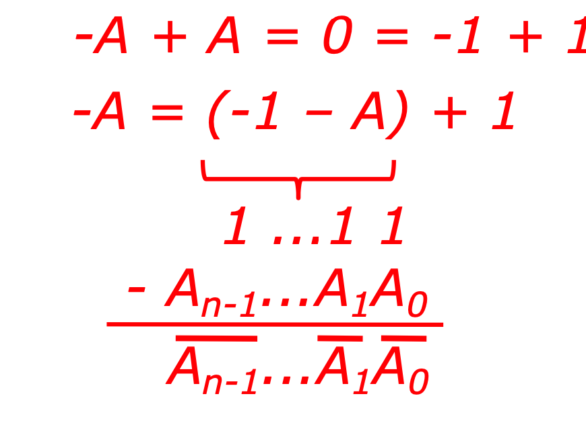
Two’s Complement and Arithmetic
To negate a number (i.e., compute –A given A), we invert all the bits and add one
Why does this work?

Slide 68
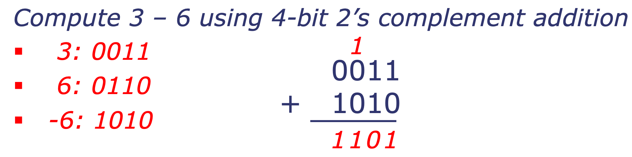
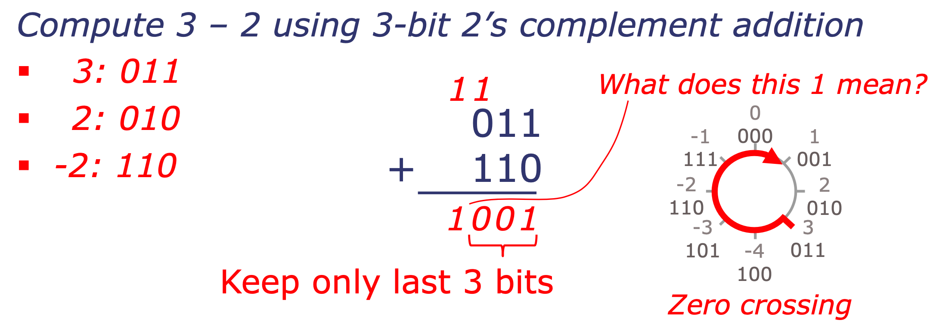
Two’s Complement and Arithmetic
To compute A-B, we can simply use addition and compute A+(-B)
Result: Same circuit can add and subtract
Example:

Slide 69
Two-complement Encoding Example (Cont.)
x = 15213: 00111011 01101101
y = -15213: 11000100 10010011

